Slide 1

Transitioning ChadaTech to Scrum-Agile: A Strategic Analysis
Pilot Project Results
Notes:
Daniel Dalton, Scrum Master
Introduce the presentation by explaining that while Waterfall served ChadaTech for years, the SNHU Travel pilot demonstrates how Agile can modernize our delivery and improve client satisfaction.

Slide 2
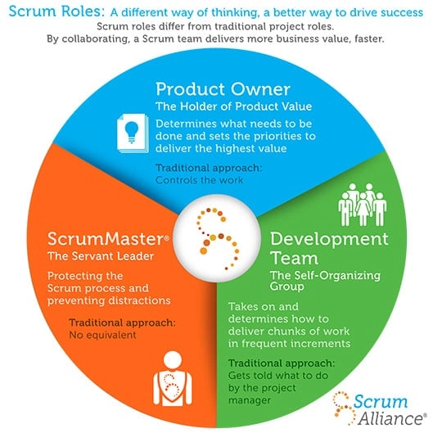
Explaining Agile Roles
The Product Owner:
  Defines the product vision and managers the Product Backlog
  Prioritizes features based on business value and ROI.
  Acts as the primary point of contact for SNHU Travel stakeholders
The Scrum Master
  Facilitates Scrum Events (Daily Stand-ups, Sprint reviews)
  Shields the team from outside interruptions
  Promotes continuous improvement by removing technical and organizational blockers.
The Development Team
  A cross-functional, sekf organizing group of 3-9 members.
  Responsible for delivering a “Done”, shippable increment every sprint.
  Has the autonomy to decide “how” to build the solutions by the PO.

Slide 3
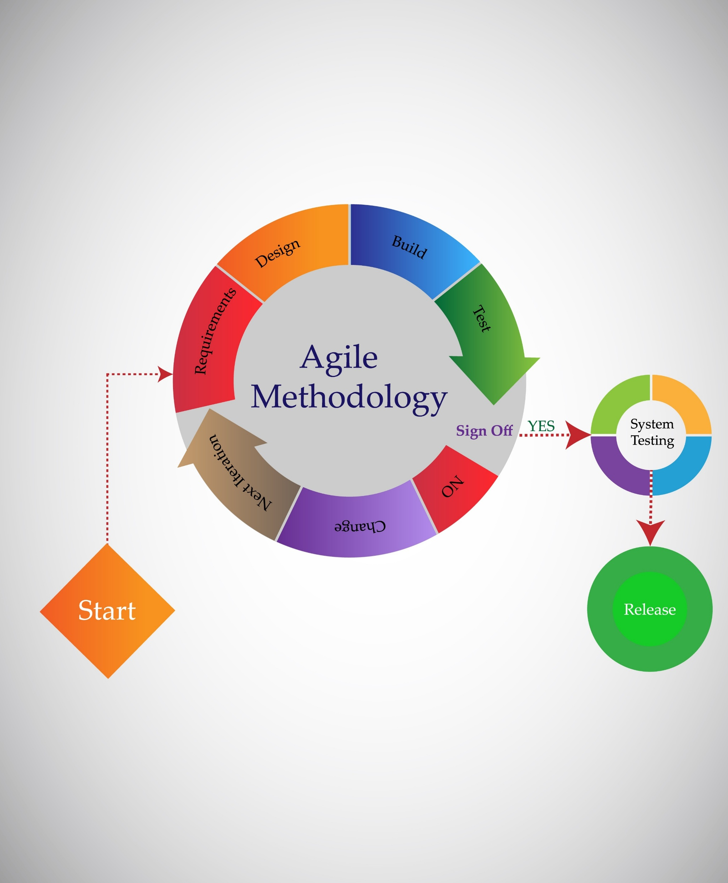
Explaining Agile Phases (The SDLC)
Requirements (The Product Backlog):
  Unlike Waterfall’s fixed documentation, Agile uses a living backlog of User Stories that evolves with the project.
Design & Development (The Sprint):
  Coding and design happen in a time-boxed cycle (typically 2 weeks). Design is iterative rather than upfront.
Testing (The Definition of Done):
  Testing in integrated into every day of the sprint. No story is “Done” until it passes QA and peer review.
Review & Retrospective (The Feedback Loop):
  Review: Showcases the working software to SNHU Travel to ensure alignment.
  Retrospective: The team analyzes their own process to become more efficient in the next sprint

Slide 4
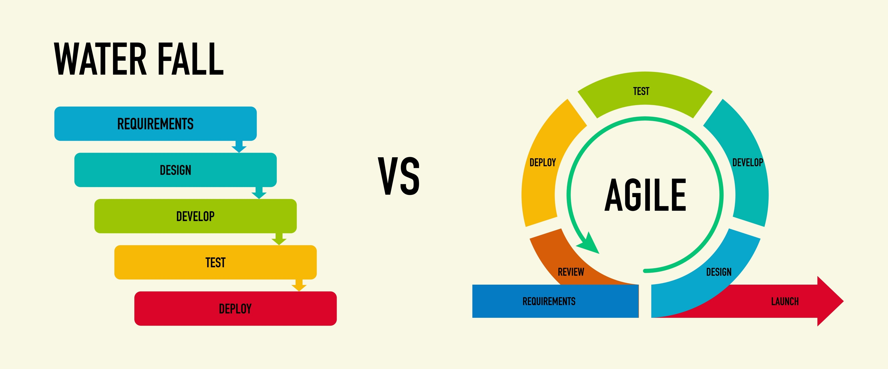
Describing the Waterfall Model
Sequential vs Overlapping:
  Waterfall follows a strict sequence (Requirements – Design – Implementation – Verification) Changes require backtracking to phase one.
The SNHU Travel Example
  In Waterfall, our mid-project pivot toward “Domestic Travel” would have required a formal change-management request and likely a 3-month delay.
Deferred Risk
  In Waterfall, the client doesn’t see the product until the end. If the requirements were misunderstood, the failure is only discovered at the very finish line.
Agile Contrast
  Because we used Scrum, we pivoted the backlog in 24 hours without wasting resources on unneeded international features.

Slide 5
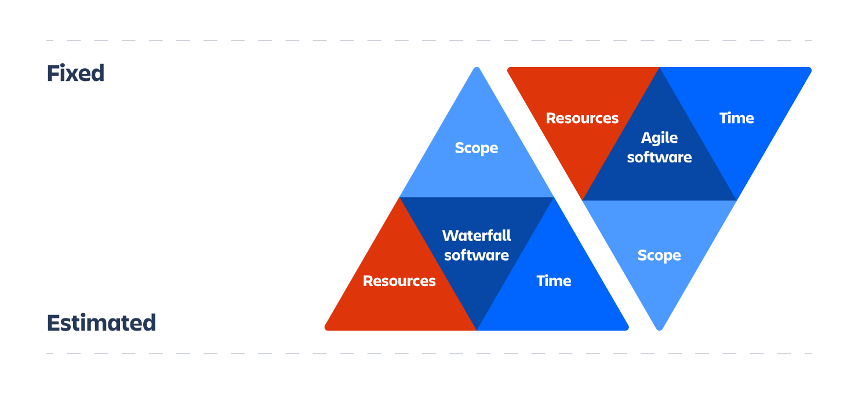
Waterfall or Agile? Factors to Consider
Clarity of Requirements:
  Use Waterfall for projects with rigid, unchanging requirements. Use Agile for innovative projects like SNHU Travel.
Project Complexity
  High-complexity projects with many unkowns benefit from the iterative “Inspect and Adapt” nature of Scrum.
Stakeholder Availability
  Agile requires the client to be involved every two weeks. If the client is “hand’s-off,” Waterfall may be necessary despite the risks.
Market Speed
  Agile allows for a Minimum Viable Product to be released early, capturing market share while the rest of the app is being built

Slide 6
References
Atlassian. (2024). The Agile Iron Triangle. Retrieved from https://www.atlassian.com/agile/agile-at-scale/agile-iron-triangle
Lucid Software. (2026). Agile Scrum Roles and Responsibilities. Retrieved from https://lucid.co/blog/agile-scrum-roles-and-responsibilities
Schwaber, K., & Sutherland, J. (2020). The Scrum Guide: The Definitive Guide to Scrum: The Rules of the Game. Retrieved from https://scrumguides.org/scrum-guide.html
Teamhood. (2026). What is Scrum? The Ultimate Guide. Retrieved from https://teamhood.com/agile-resources/what-is-scrum/

